Slide 1

BetLang
By Kriztian Serraon

Slide 2
Programming Language Purpose & Philosophy
BetLang is a DSL with the purpose of simulating casino games to determine the likelihood of winning.
My inspiration to make this language was from my favorite game CS2
In game there is a loot box feature where you open cases for a chance to get a digital skin.
BetLang brings awareness to gambling and lets people gamble in a safe and simulated environment.
BetLang aims to explore the likelihood of profiting or losing money from gambling.
Users can experiment with different betting strategies.

Slide 3
Programming Language Style
This language will use a simple syntax that includes conditions, functions, and multiple games.
Grammar (BetLang.tx): Defines the syntax for commands like bankroll, bet, for, if, and simulate.
Interpreter (gamble.py): Parses and interprets the language, executes commands and provides the output.
Data types that will be used are integers
Libraries: random

Slide 4
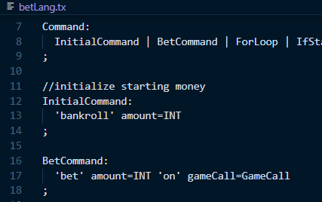
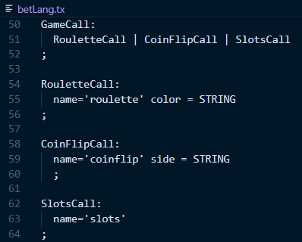
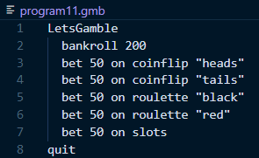
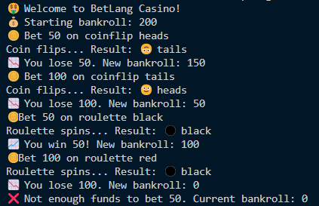
Program 1: demonstrates betting on different games

Slide 5
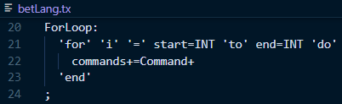
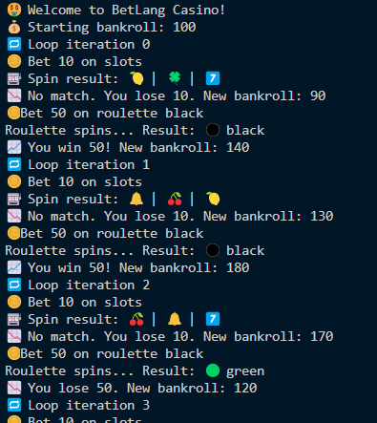
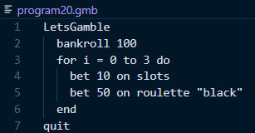
Program 2: demonstrates for-loop command

Slide 6
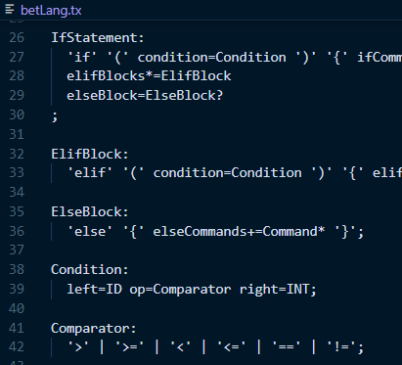
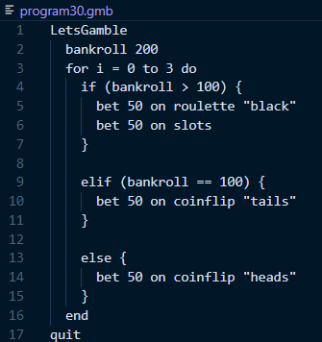
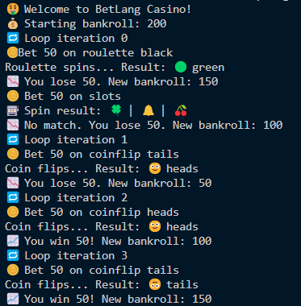
Program 3: demonstrates if-statement

Slide 7
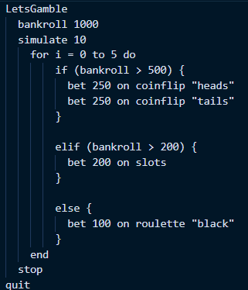
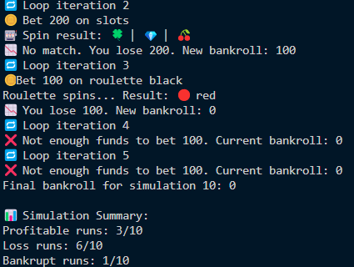
Program 4: demonstrates simulate command

Slide 8
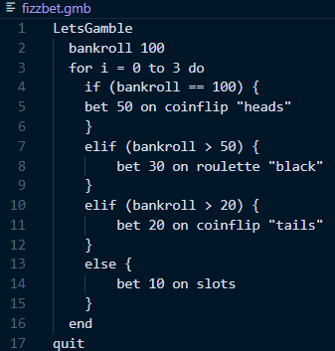
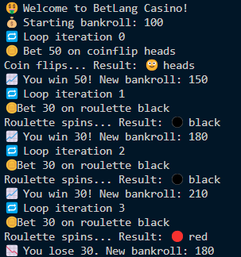
Program 5: demonstrates FizzBuzz program

Slide 9
Future Improvements
Adding more games like: blackjack, blackjack conditionals, craps, etc.
Adding more functions like: multiple conditional statements, total profit counter, etc.

Slide 10
Thank You for Listening!

